Slide 1


HealthNet : Multi-Disease Prediction
using Machine Learning Classification
By Team AiGeeks
Jai Singhal [E22CSEU0536]
Ikshit Mangal [E22CSEU0525]
Raghav Garg [E22CSEU0521]

Slide 2
Table of contents
01
02
03
04
05
Introduction
Problem & solution
Individual Contribution
Work done
References

Slide 3
Introduction
Welcome to HealthNet, where innovation meets compassion in the realm of healthcare technology. At HealthNet, we are dedicated to revolutionizing patient care through advanced data analytics and predictive modeling. Our mission is simple yet profound: to empower healthcare professionals with the tools and insights they need to enhance patient outcomes and improve lives. With a relentless commitment to excellence, integrity, and patient-centricity, we strive to push the boundaries of what's possible in predictive healthcare. From early disease detection to personalized treatment recommendations, HealthNet is at the forefront of harnessing the power of technology to transform the way we approach healthcare. Join us on our journey as we pave the way for a healthier, more vibrant future for all.

Slide 4
HealthNet:Multi-Disease Prediction
Objective
Scope
Key Features
To develop a predictive healthcare system capable of identifying multiple diseases through data analysis and machine learning algorithms.
HealthNet aims to leverage patient data, including medical history, symptoms, and demographic information, to predict the likelihood of various diseases.
Integration of diverse data sources.
Implementation of advanced machine learning models.
User-friendly interface for healthcare professionals.

Slide 5
HealthNet: Multi-Disease Prediction
Challenges
Innovative solutions
Handling large-scale healthcare data.
Ensuring patient privacy and data security.
Dealing with data heterogeneity and quality issues.
Interpretability and explainability of predictive models.
Early disease detection leading to timely interventions.
Improved patient outcomes and healthcare resource allocation.
Empowering healthcare providers with data-driven insights for personalized care.
Potential for reducing healthcare costs and burden on the system.

Slide 6
Proposes solution approach
Data Collection
Data Preprosessing
Gather diverse datasets including patient records, lab results, imaging data, and demographic information while ensuring data integrity and privacy compliance.
Cleanse, normalize, and format data to address inconsistencies, missing values, and outliers for accurate analysis.
Feature Selection
Model Development
Identify relevant features through exploratory data analysis and domain expertise to enhance predictive modeling.
Implement machine learning algorithms such as logistic regression, random forests, and neural networks tailored to healthcare data for disease prediction.
Evaluation
Iterative Refinement
Assess model performance using metrics like accuracy, precision, recall, and F1-score to validate predictive capability and refine models iteratively.
Continuously refine data collection, preprocessing techniques, feature engineering, and model architectures based on feedback and evolving healthcare needs.

Slide 7
Individual Contribution [by AiGeeks]
Jai Singhal [E22CSEU0536]
Jai leads data acquisition and preprocessing efforts, ensuring data integrity and compliance. He specializes in feature selection and contributes to model implementation.
Ikshit Mangal [E22CSEU0525]
Ikshit takes charge of model development, fine-tuning algorithms, and conducting evaluations. He also manages project documentation to ensure clear communication of milestones.
Raghav Garg [E22CSEU0521]
Raghav is an expert in preprocessing, handling data cleaning and feature engineering. He collaborates closely with the team, bringing innovative modeling techniques to the project.

Slide 8
Timeline
Data Collection and Preprocessing
Model Development
Evaluation and Validation
Iterative Refinement
User Interface Design
Final Evaluation and Presentation

Slide 9
Work Done
Data Collection and Preprocessing
Acquired and cleaned diverse datasets from healthcare institutions and research repositories.
Standardized data formats and resolved inconsistencies.
Feature Selection and Engineering
Identified relevant biomarkers and clinical indicators for disease prediction.
Conducted feature engineering to enhance predictive power.
Selected optimal feature subset using advanced statistical methods.
Model Development
Developed multiple AI models including neural networks and decision trees.
Implemented state-of-the-art machine learning algorithms for disease prediction.
Fine-tuned models using cross-validation to optimize performance.

Slide 10
Work Done
Training and Validation
Split data into training, validation, and testing sets.
Trained AI models using training data to learn disease patterns.
Validated models using validation set to ensure generalization.
Performance Evaluation
Evaluated models using various metrics such as accuracy, sensitivity, and specificity.
Generated ROC curves and confusion matrices to assess model performance.
Compared results with baseline models and existing methods.
Results and Analysis
Obtained promising results in disease prediction across multiple conditions.
Demonstrated superior performance compared to traditional diagnostic methods.
Conducted in-depth analysis of model predictions and insights gained.

Slide 11
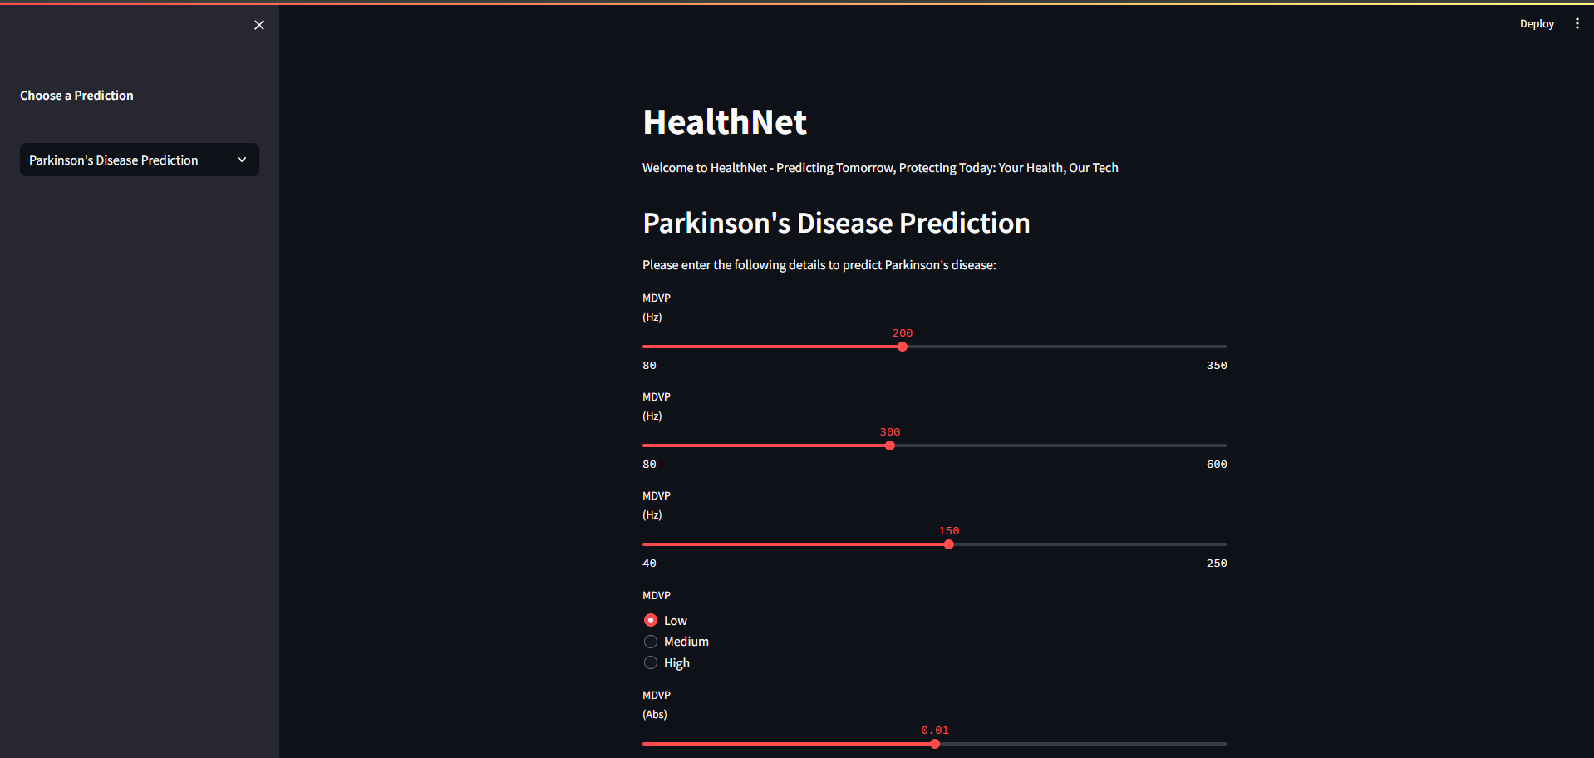

Slide 12
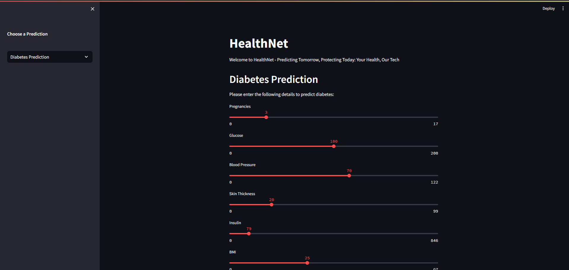

Slide 13
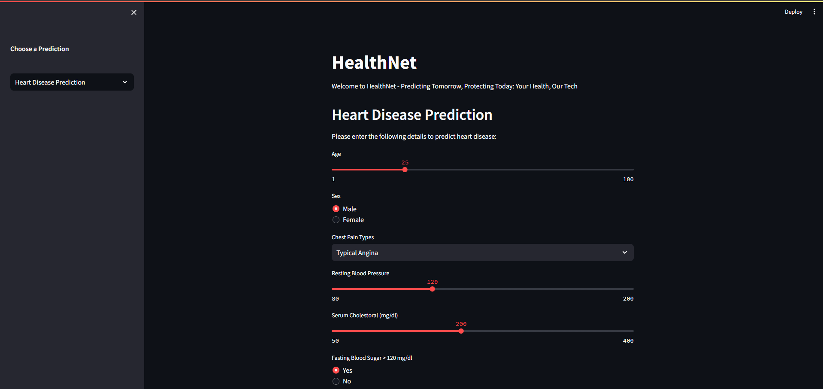

Slide 14
References
PubMed (https://pubmed.ncbi.nlm.nih.gov/)
UCI Machine Learning Repository (https://archive.ics.uci.edu/ml/index.php)
Stack Overflow (https://stackoverflow.com)
GitHub (https://github.com)
arXiv (https://arxiv.org)
scikit-learn (sklearn) (https://scikit-learn.org/stable)

Slide 15
Thanks!
Do you have any questions?
support@HealthNet.com
+1234567899
HealthNet.com

